Slide 1

Covid
Analysis
Peru, India, United States, France and Spain
Presented by Kapil Dadlani,
Juan Guerrero and María Cagigas
COVID PROJECT | ENERO 2021

Slide 2


Workflow
COVID PROJECT | ENERO 2021

Slide 3




Data
Data Wrangling
Data Cleaning
Json
B Group
COVID PROJECT | ENERO 2021

Slide 4
Data
Data Wrangling
Data Cleaning
Json
B Group
COVID PROJECT | ENERO 2021

Slide 5

Data
Data Wrangling
Data Cleaning
10 columns for tendencies
4 about information
1 about the json
Json
B Group
COVID PROJECT | ENERO 2021

Slide 6
Data
Data Wrangling
Data Cleaning
Json
B Group
COVID PROJECT | ENERO 2021

Slide 7



Data
Api
Data Wrangling
Group_id
B88
Token
B88
Error
Data Cleaning
Token_id
Json
B Group
Error
Json
B Group
COVID PROJECT | ENERO 2021

Slide 8

Data
Api
Data Wrangling
Group_id
Console
B88
Token
B88
Error
Data Cleaning
Token_id
!= j 18
= j 18
Json
B Group
Error
Json
B Group
Json
B Group
Error
COVID PROJECT | ENERO 2021

Slide 9


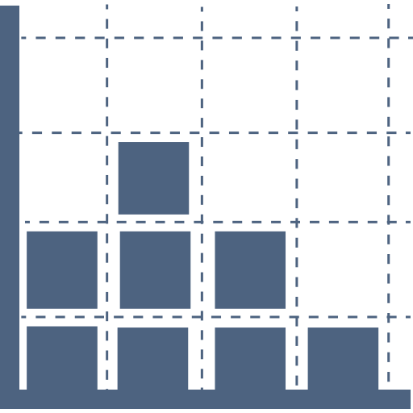

Data
Data Visualization
Data Wrangling
Tendencies
Matrix
Correlation
Data Cleaning
Conclusions
Json
B Group
COVID PROJECT | ENERO 2021

Slide 10



Visualization
COVID PROJECT | ENERO 2021

Slide 11
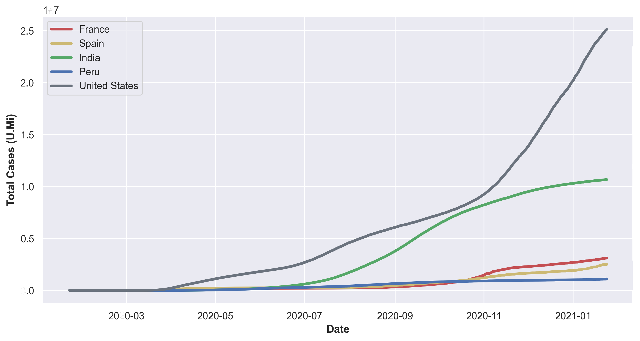
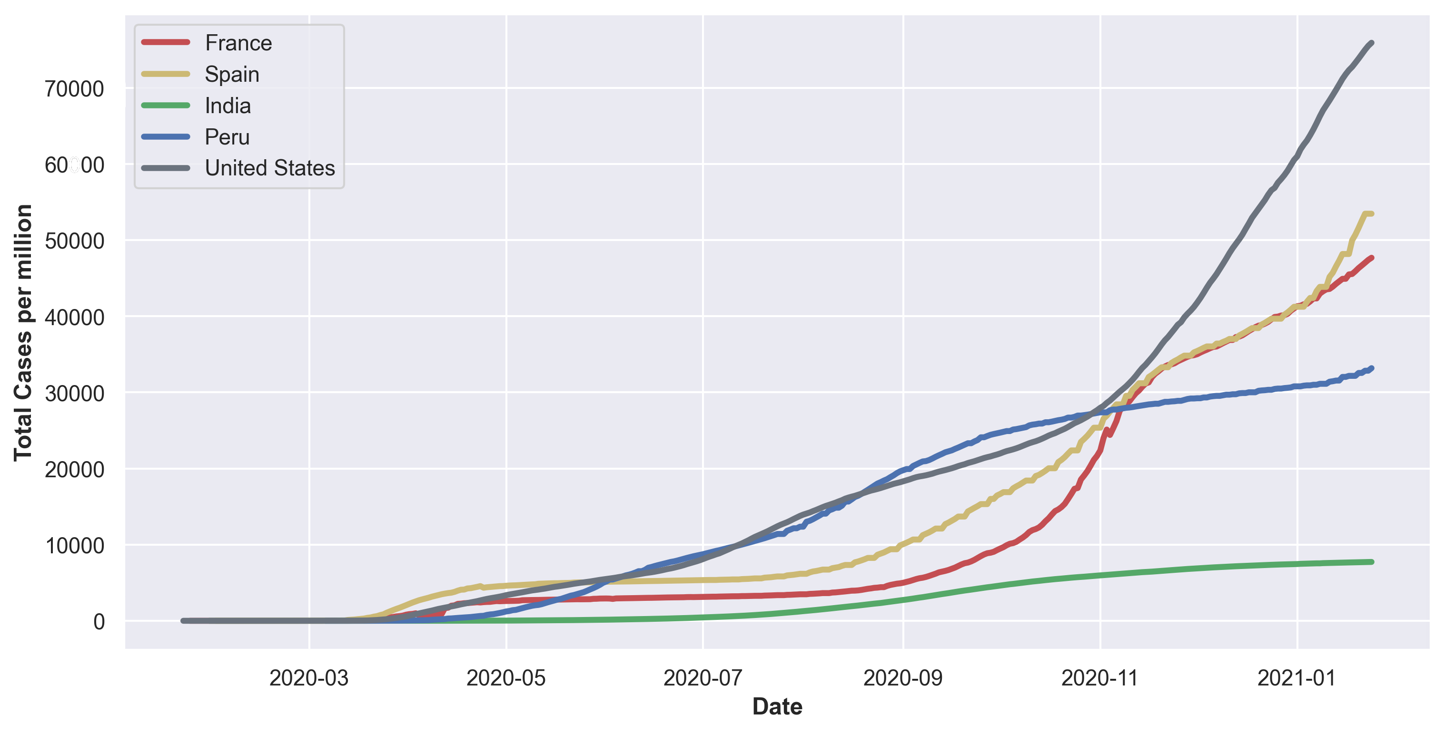
COVID
Total cases VS Cases per million
COVID PROJECT | ENERO 2021

Slide 12
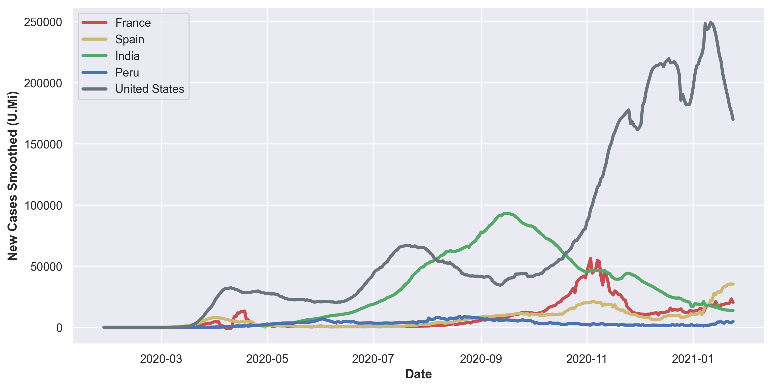
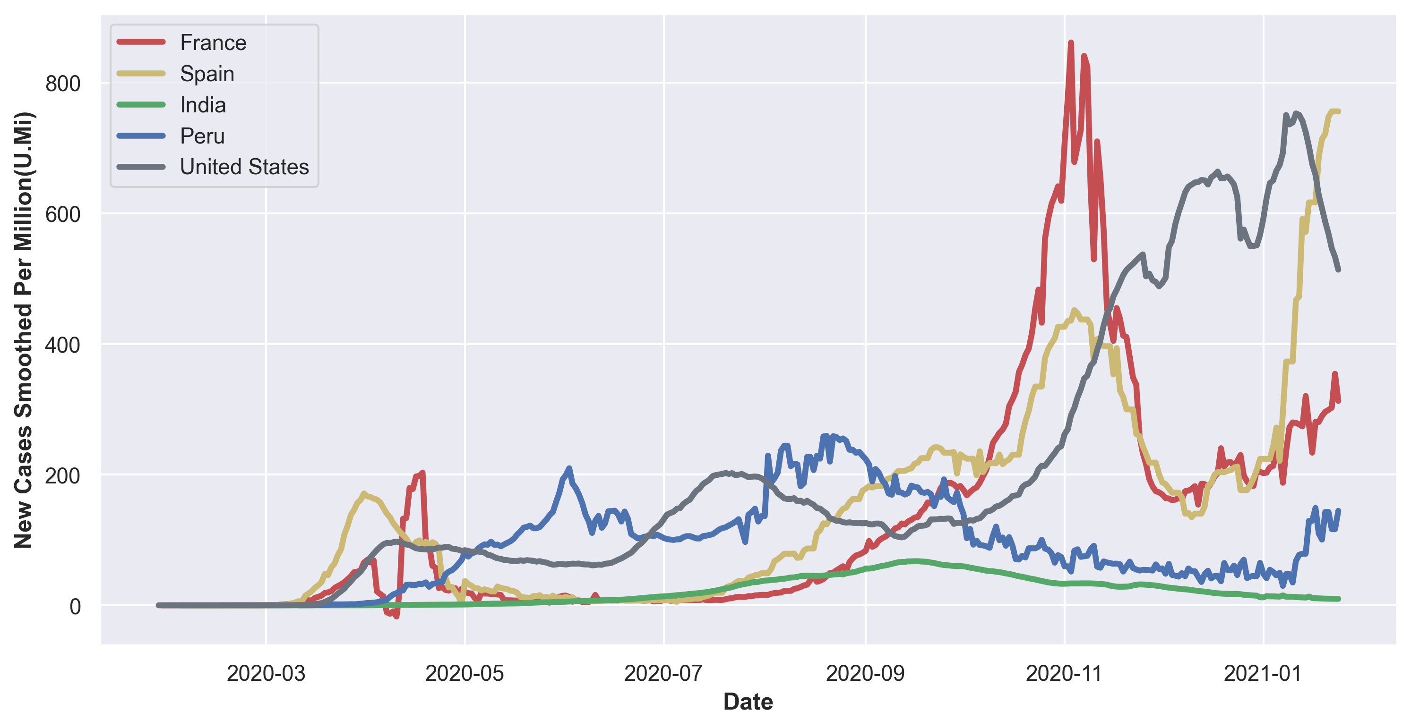
COVID
New cases VS New cases per million
COVID PROJECT | ENERO 2021

Slide 13
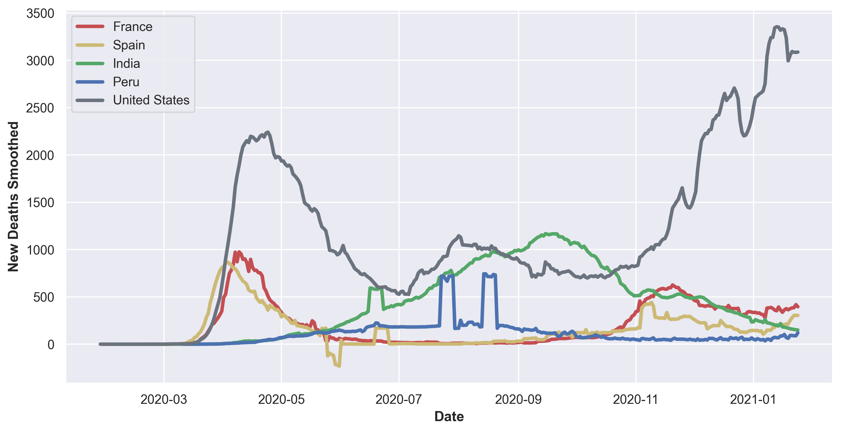
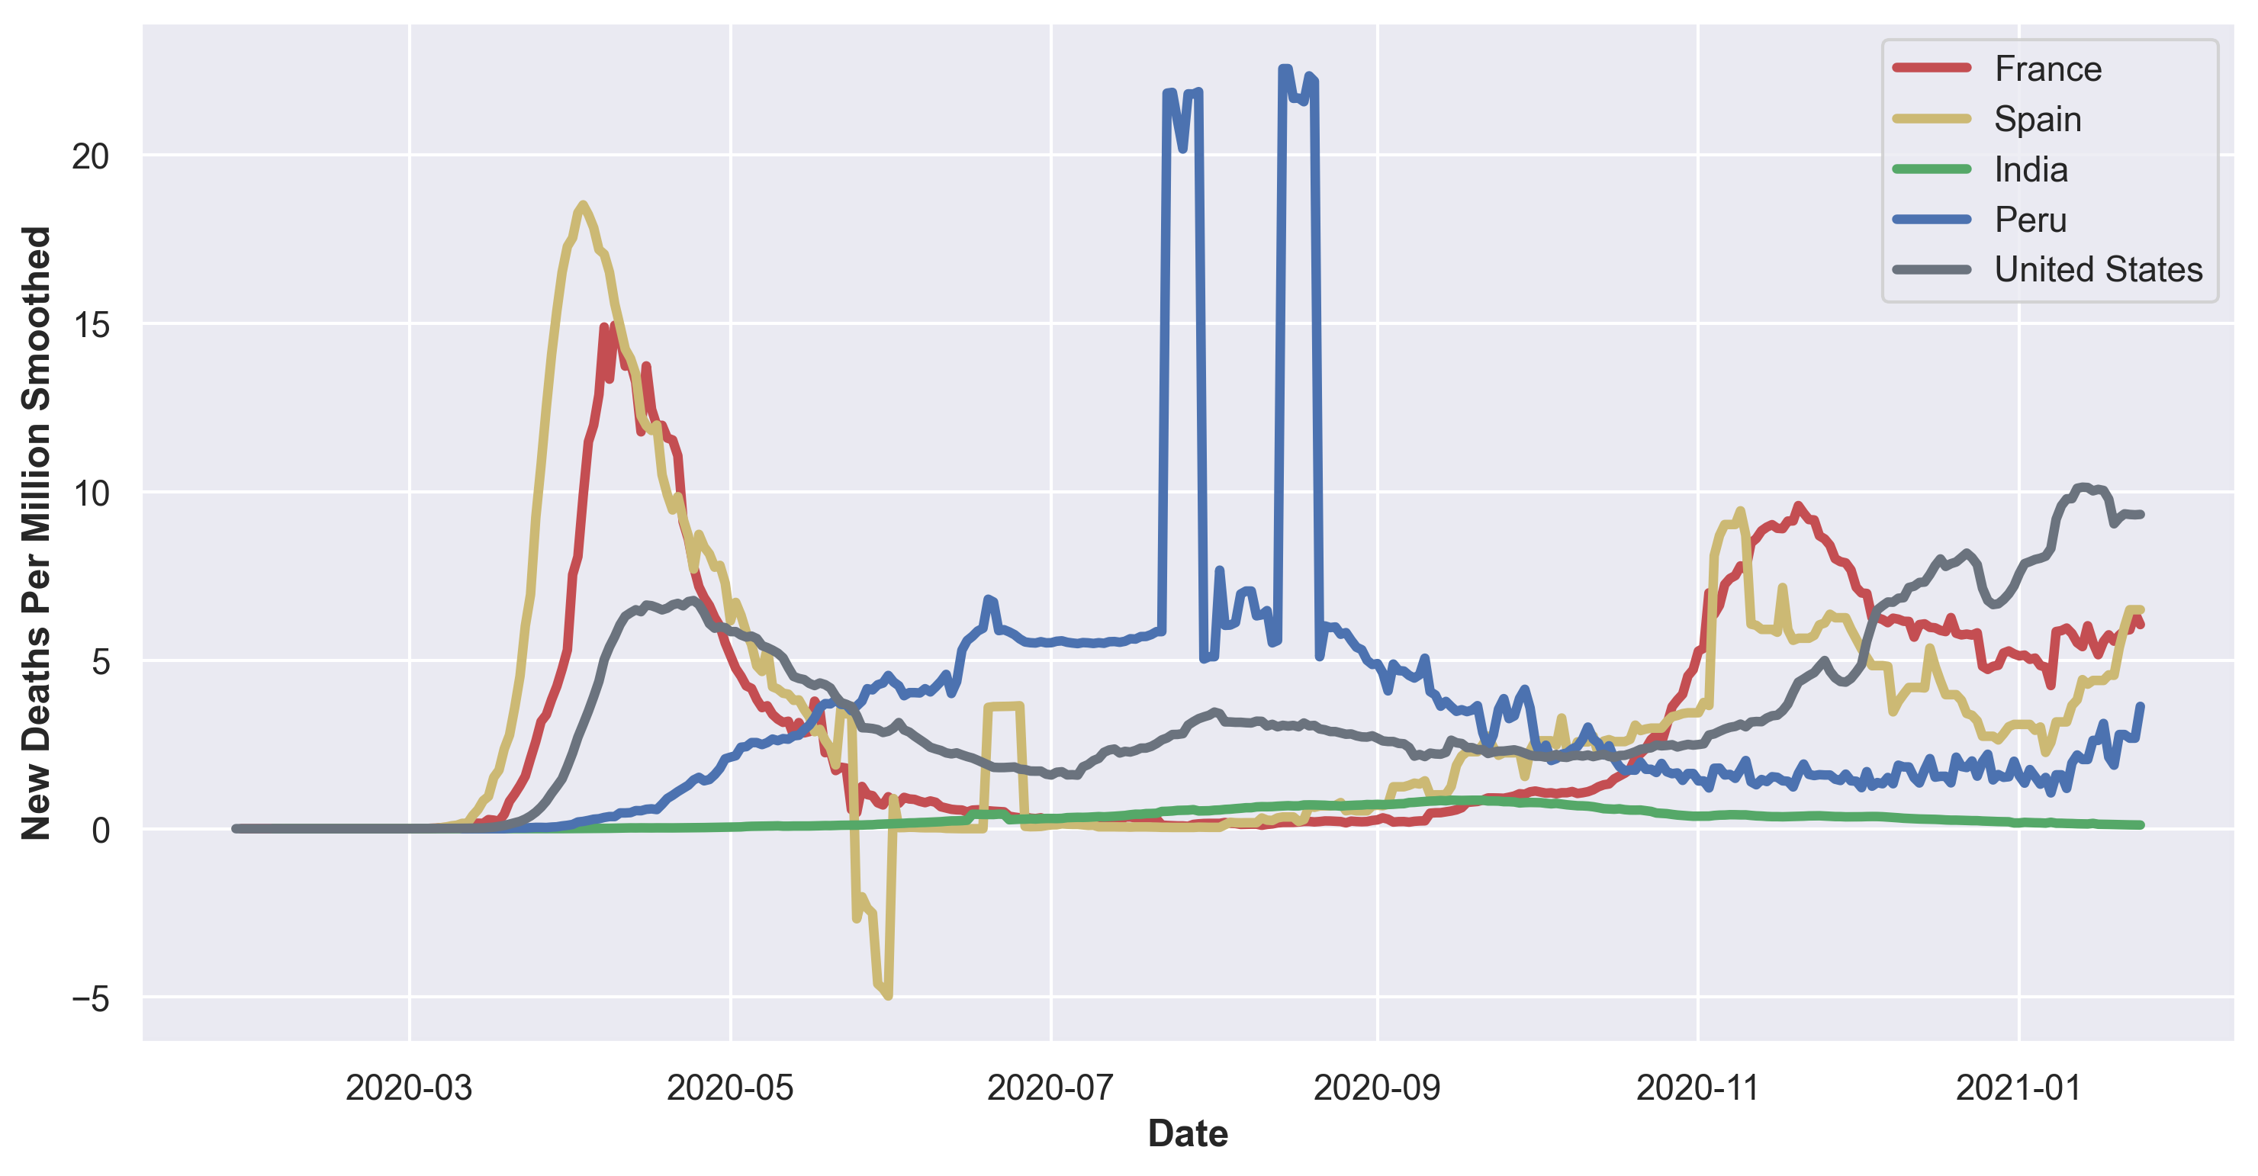
COVID
New deaths VS New deaths per million
COVID PROJECT | ENERO 2021

Slide 14
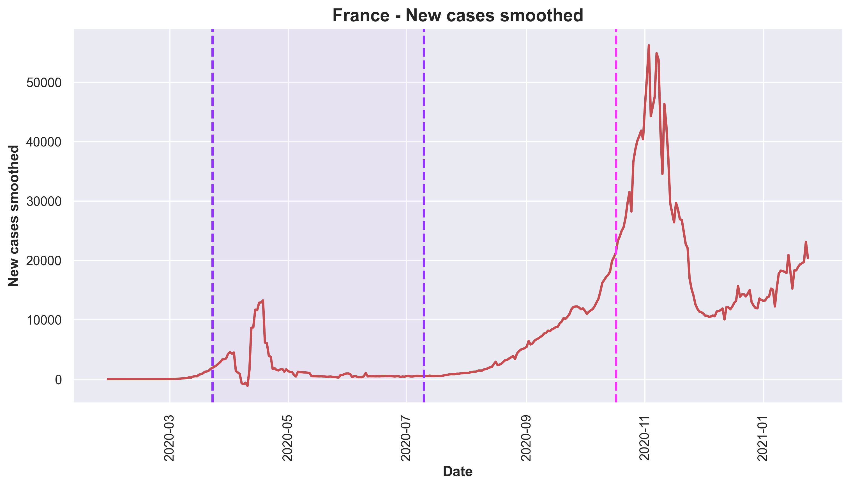
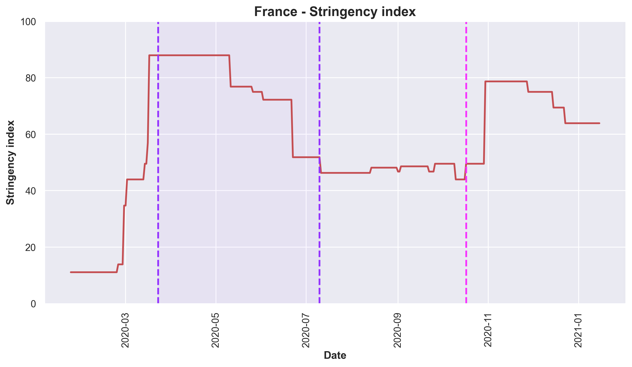
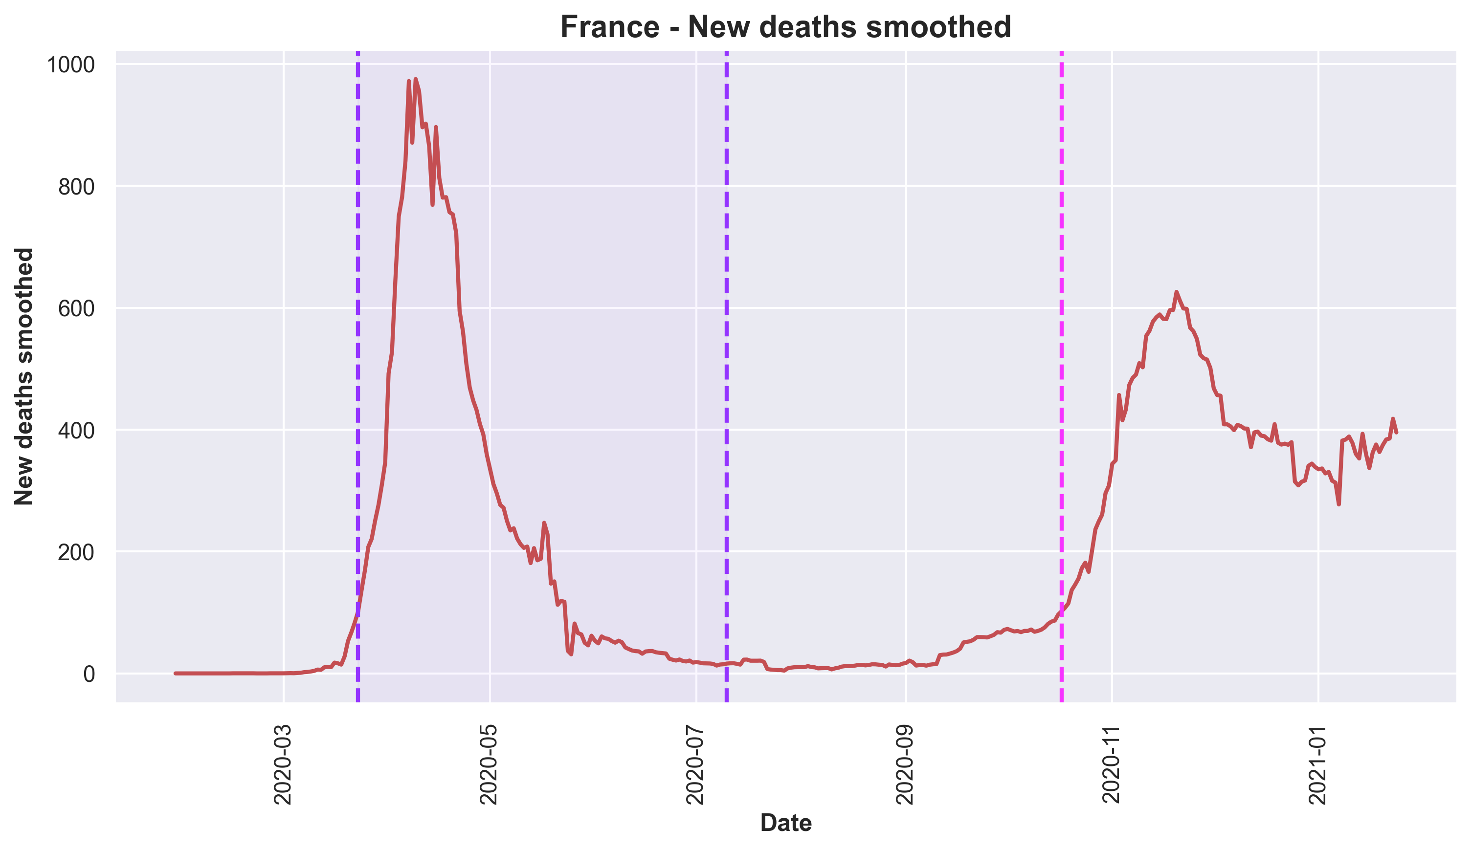
France
COVID PROJECT | ENERO 2021

Slide 15
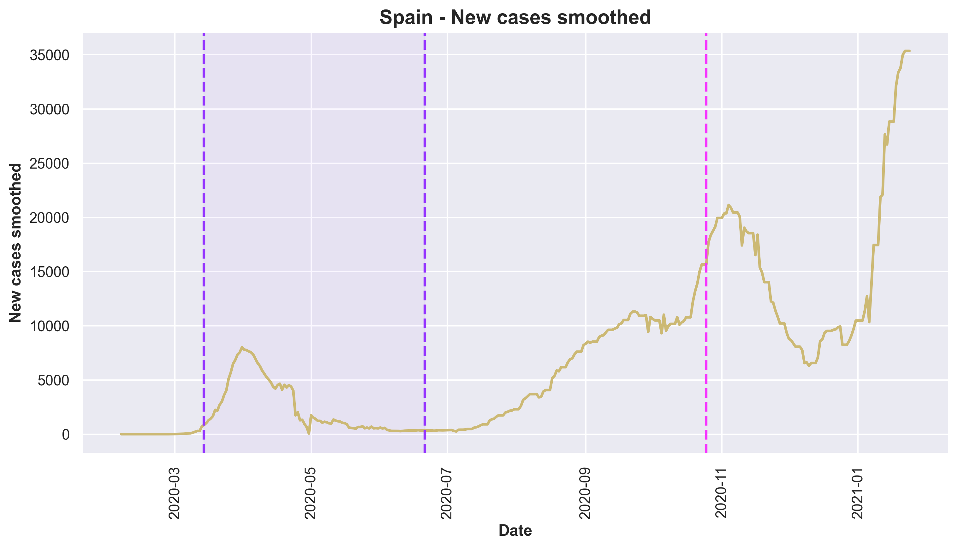
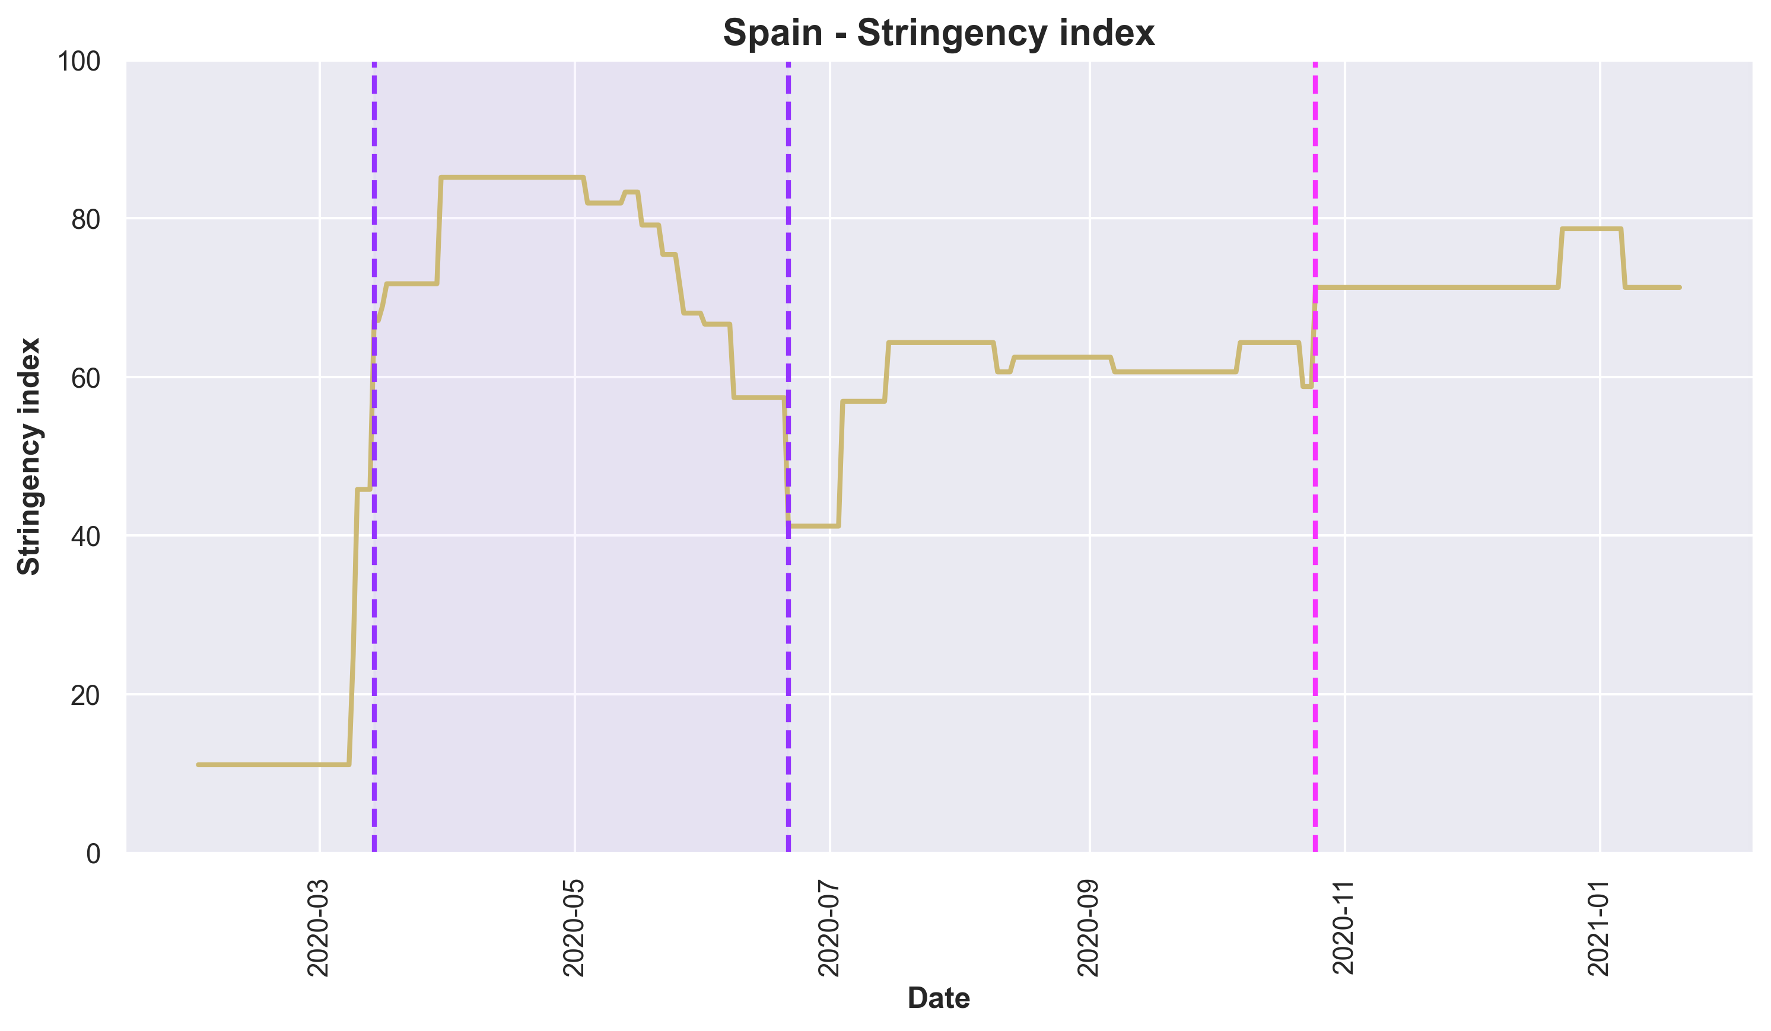
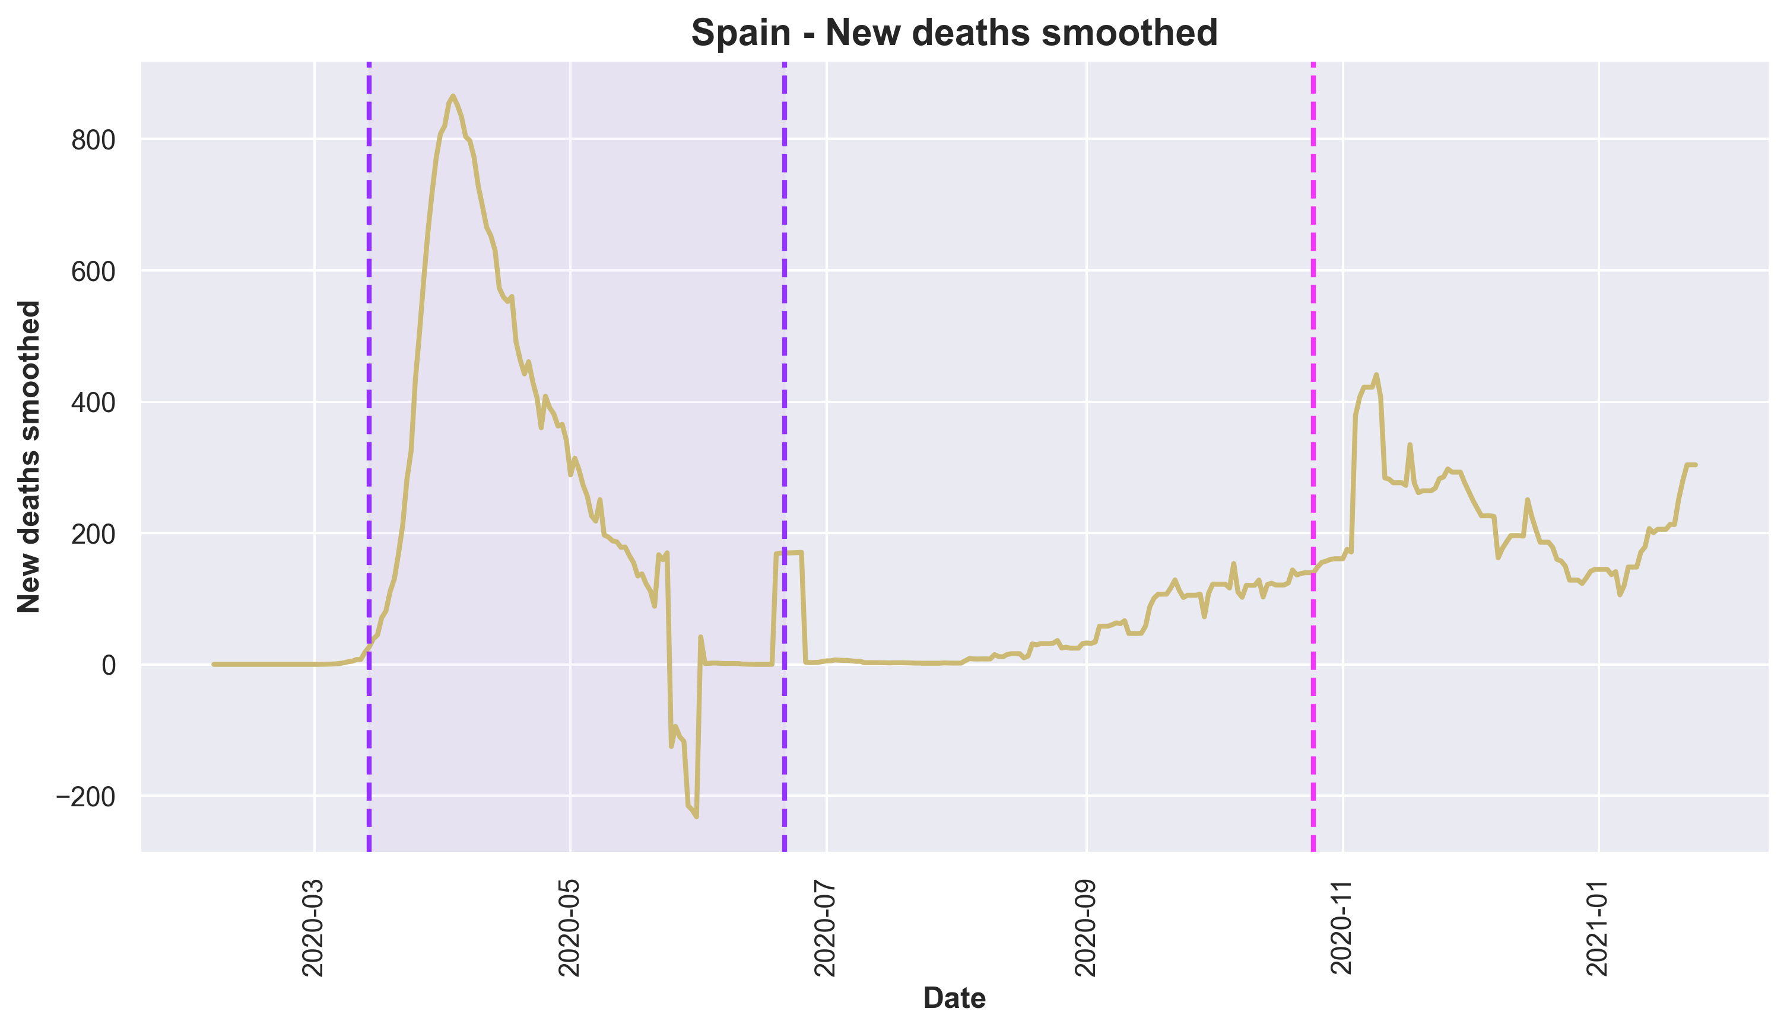
Spain
COVID PROJECT | ENERO 2021

Slide 16
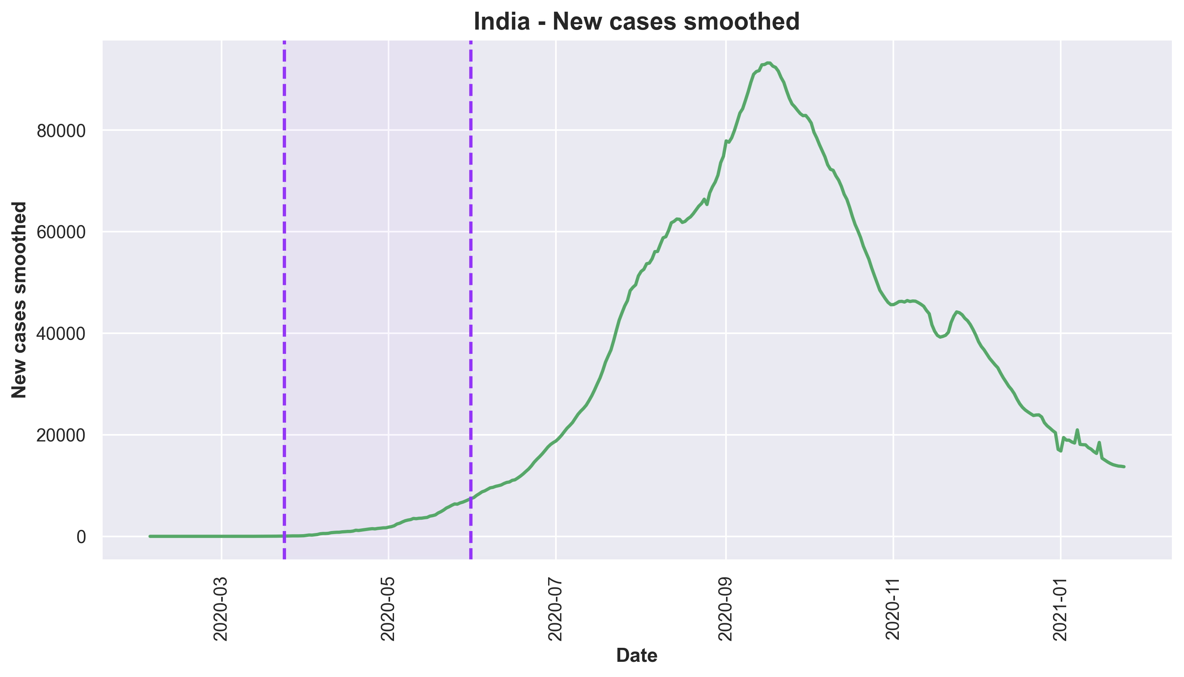
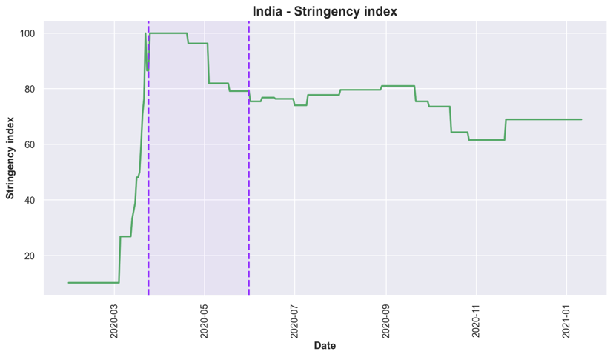
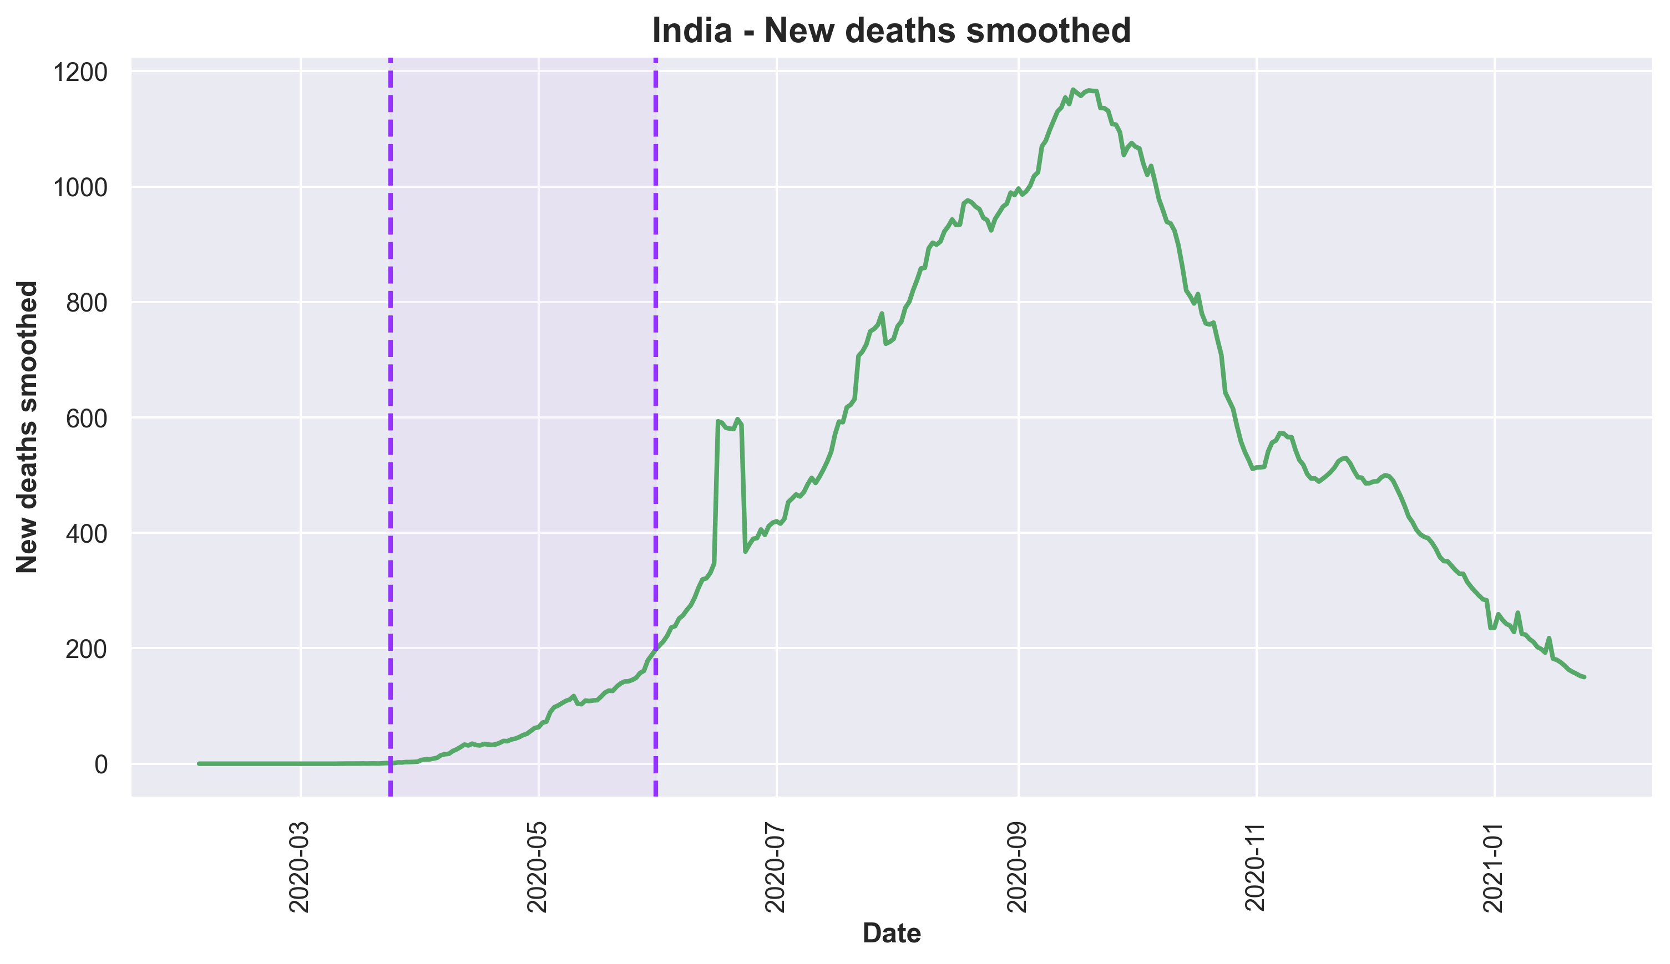
India
COVID PROJECT | ENERO 2021

Slide 17
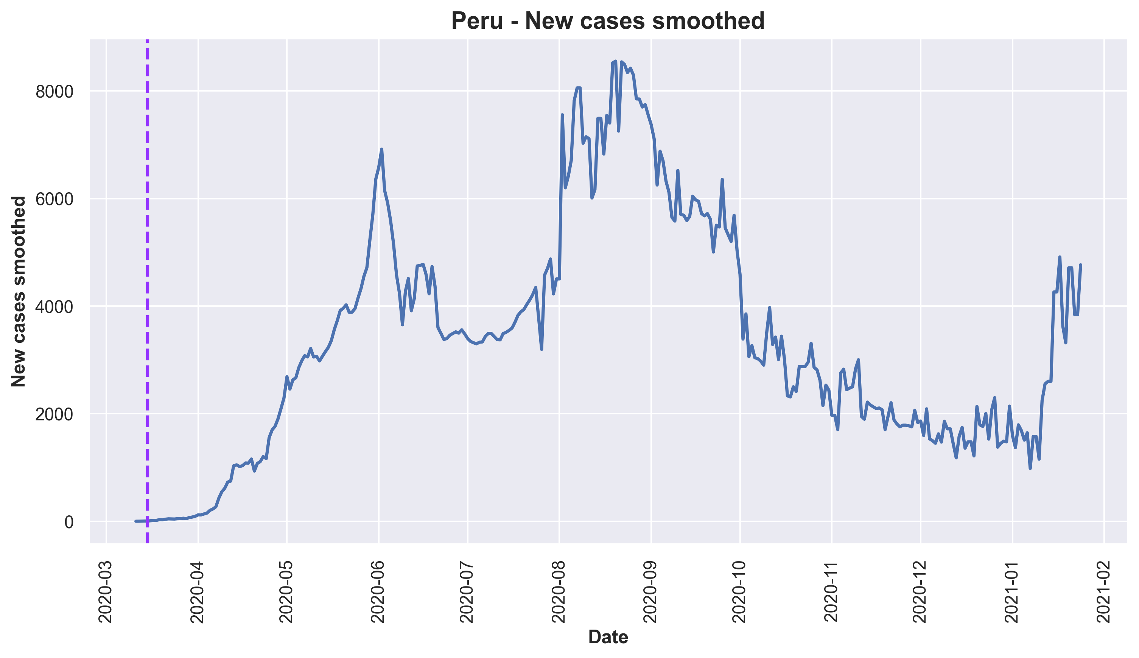
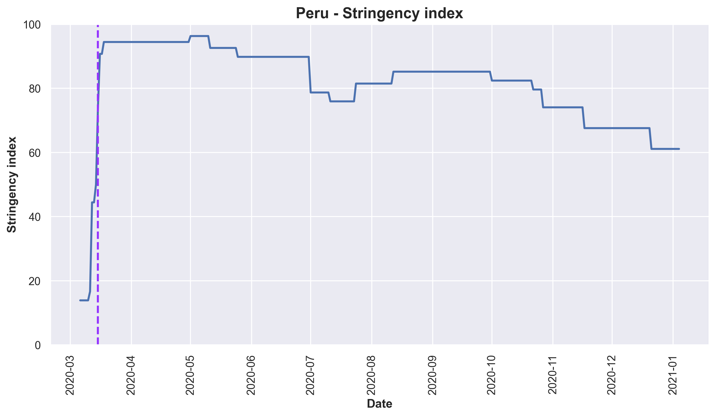
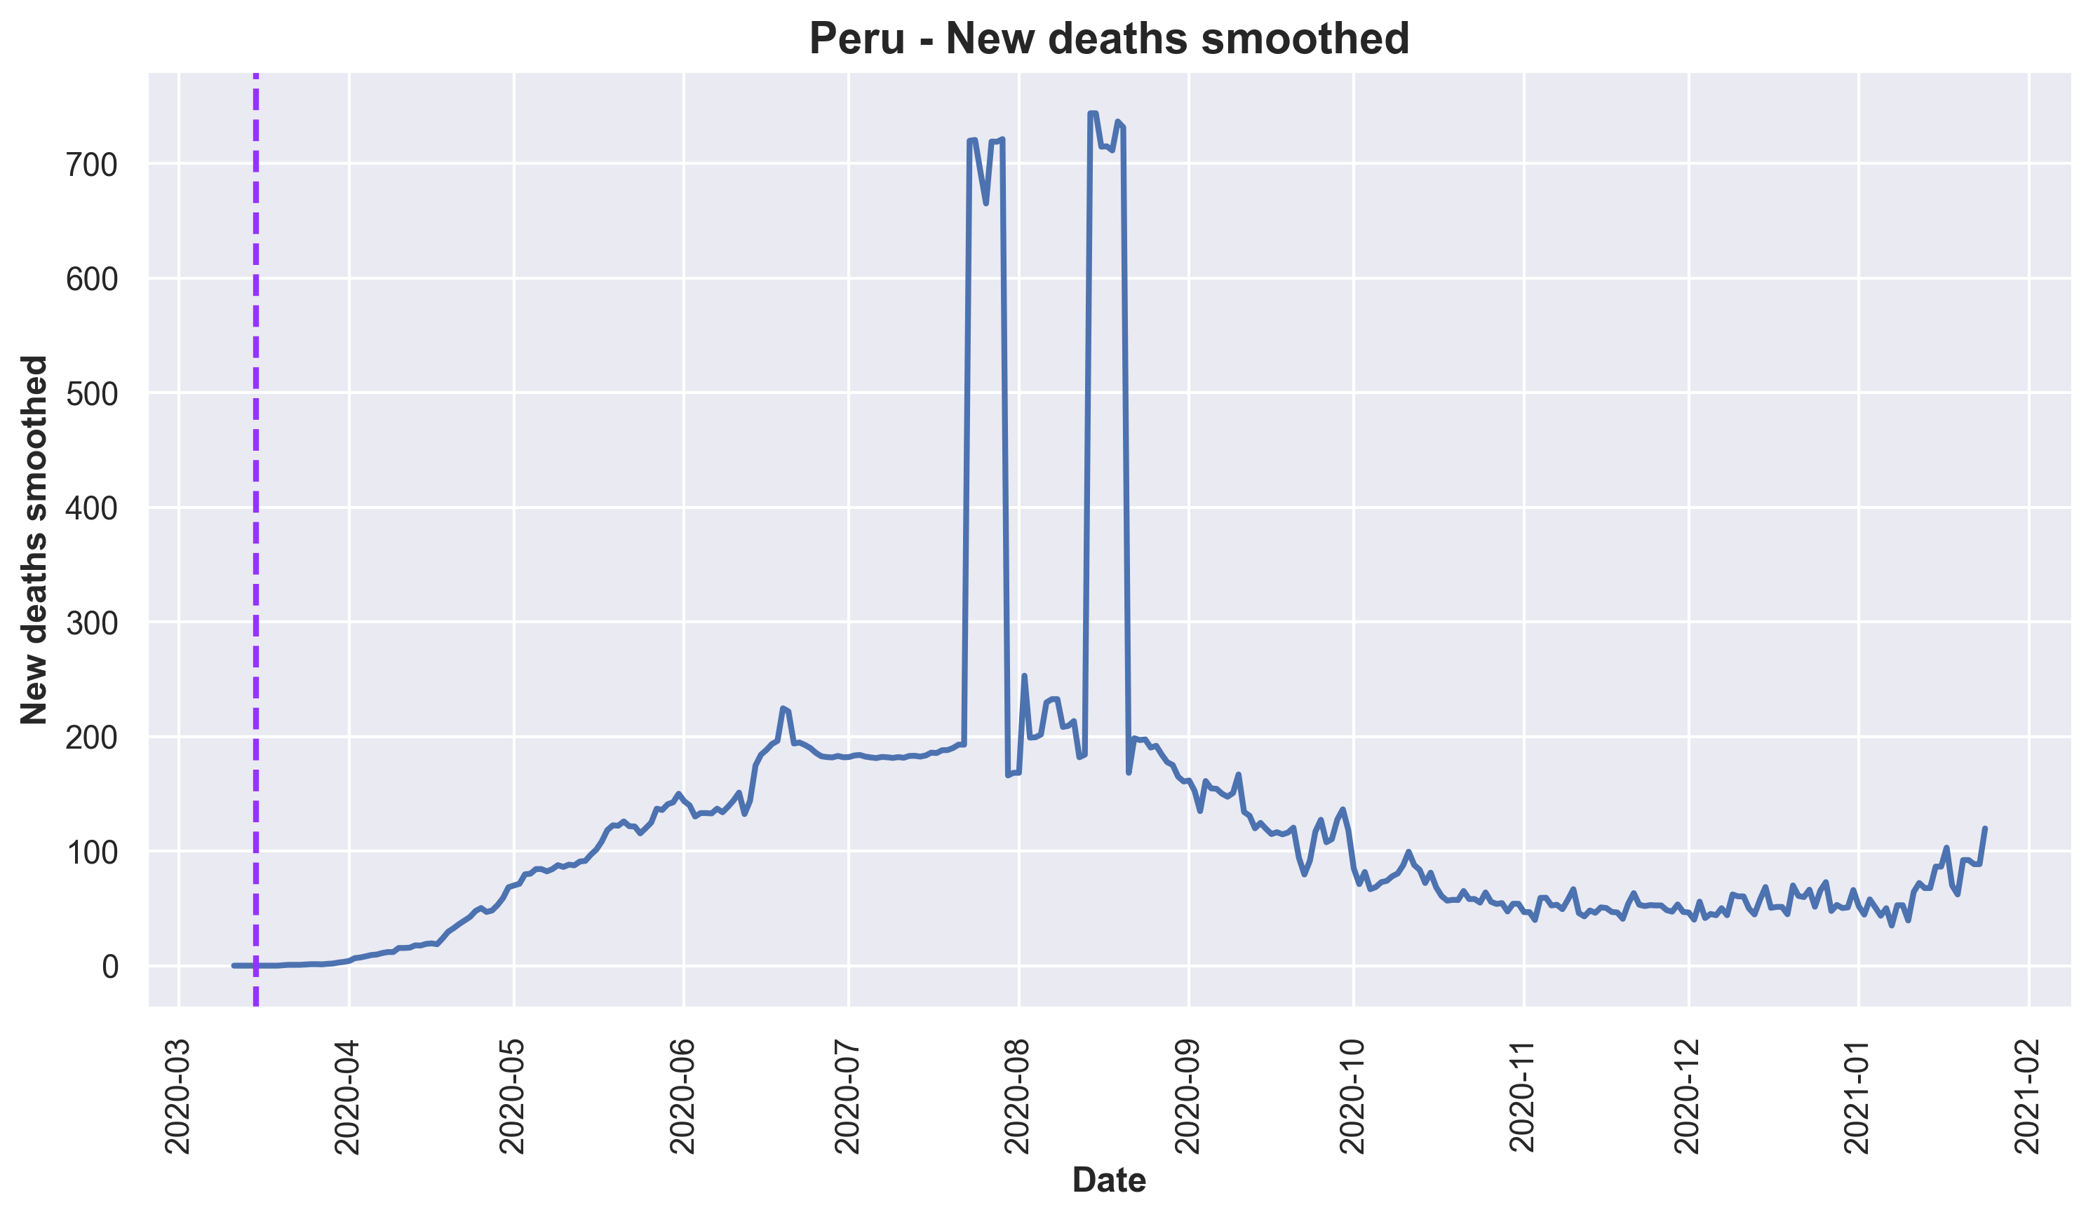
Peru
COVID PROJECT | ENERO 2021

Slide 18
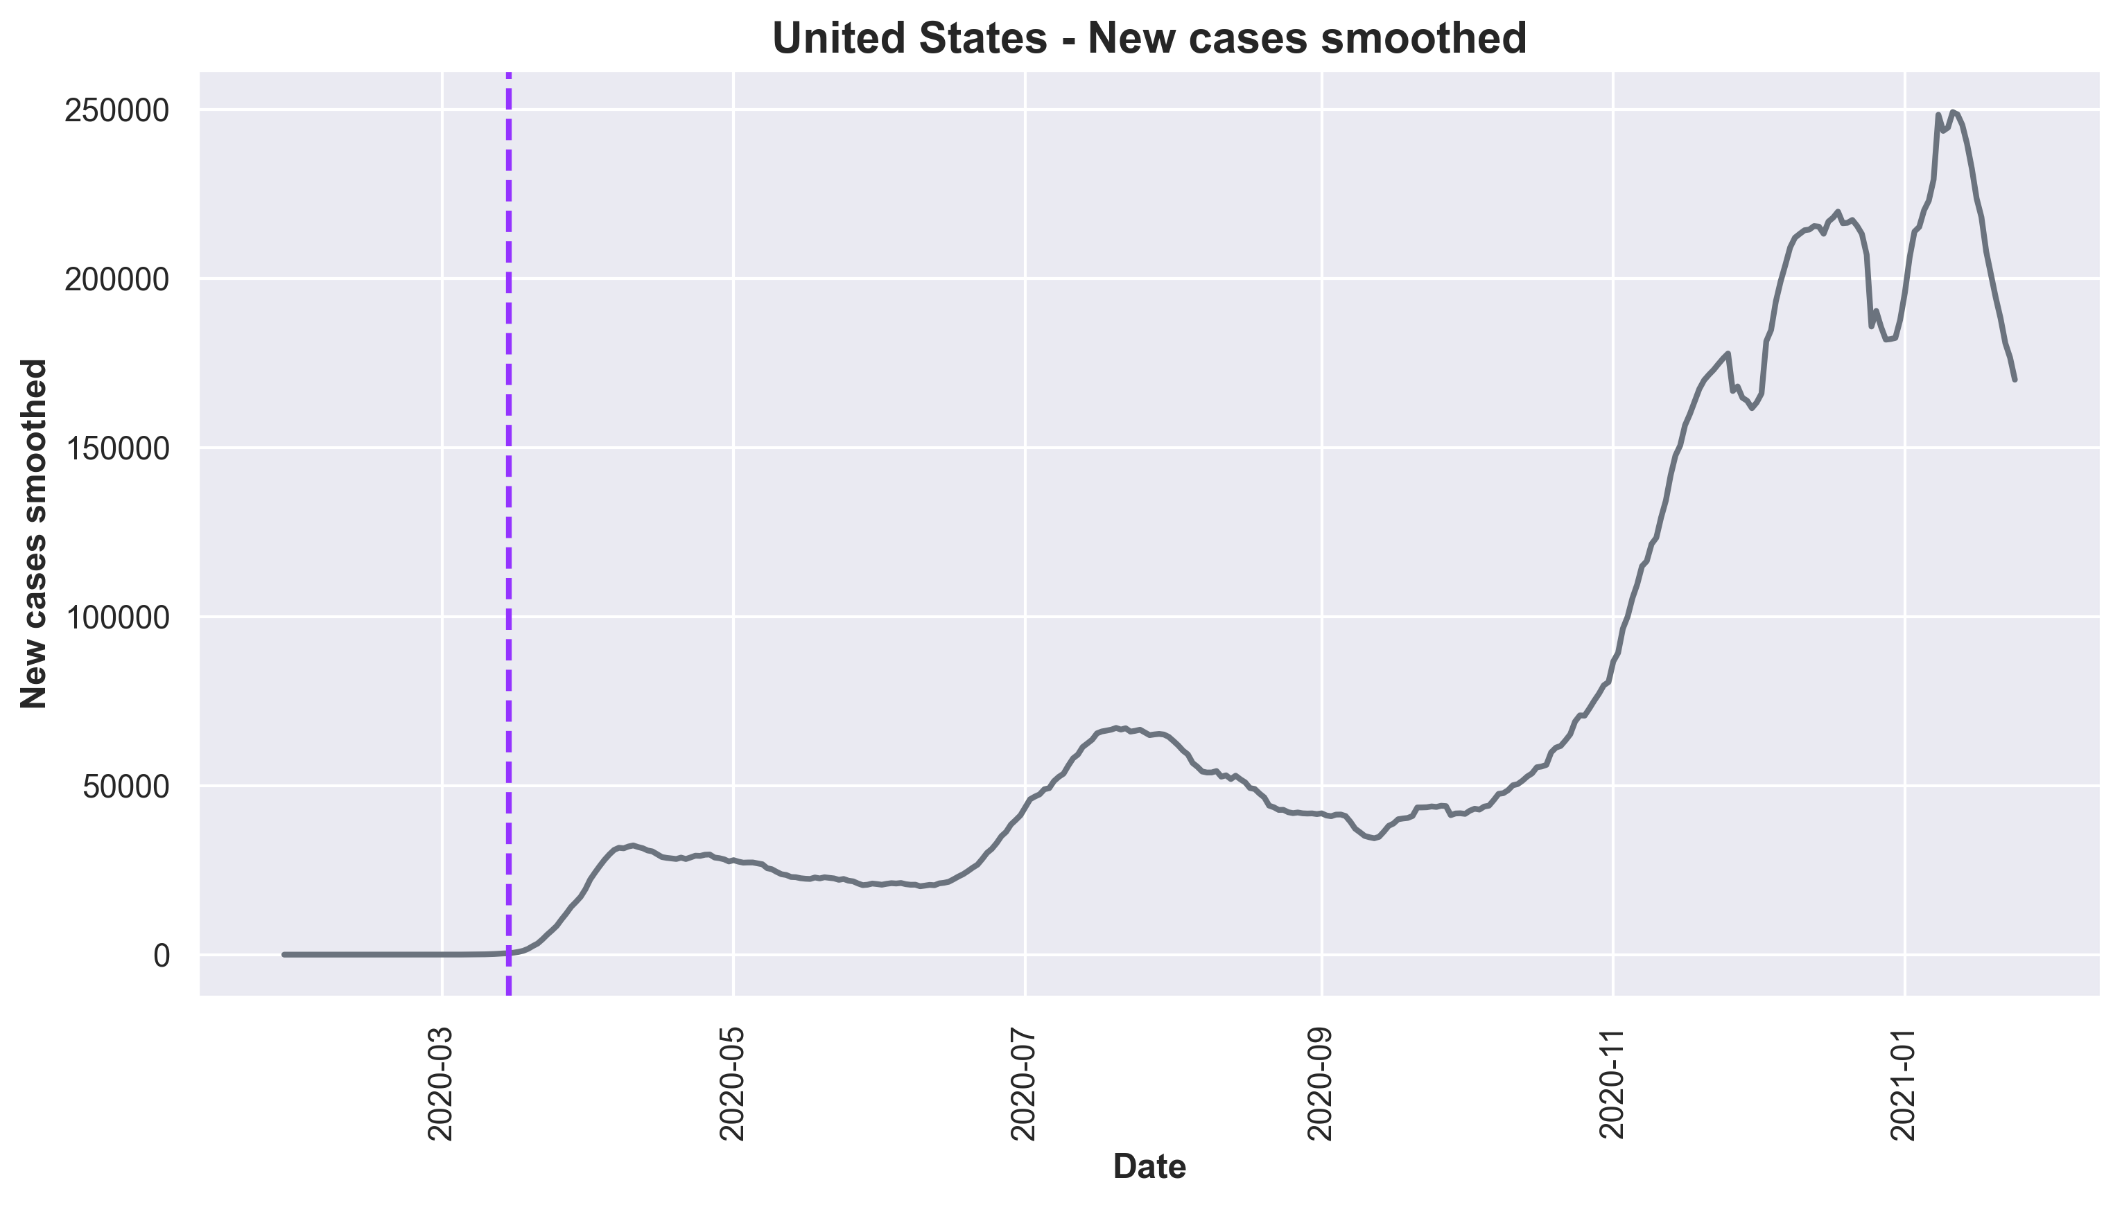
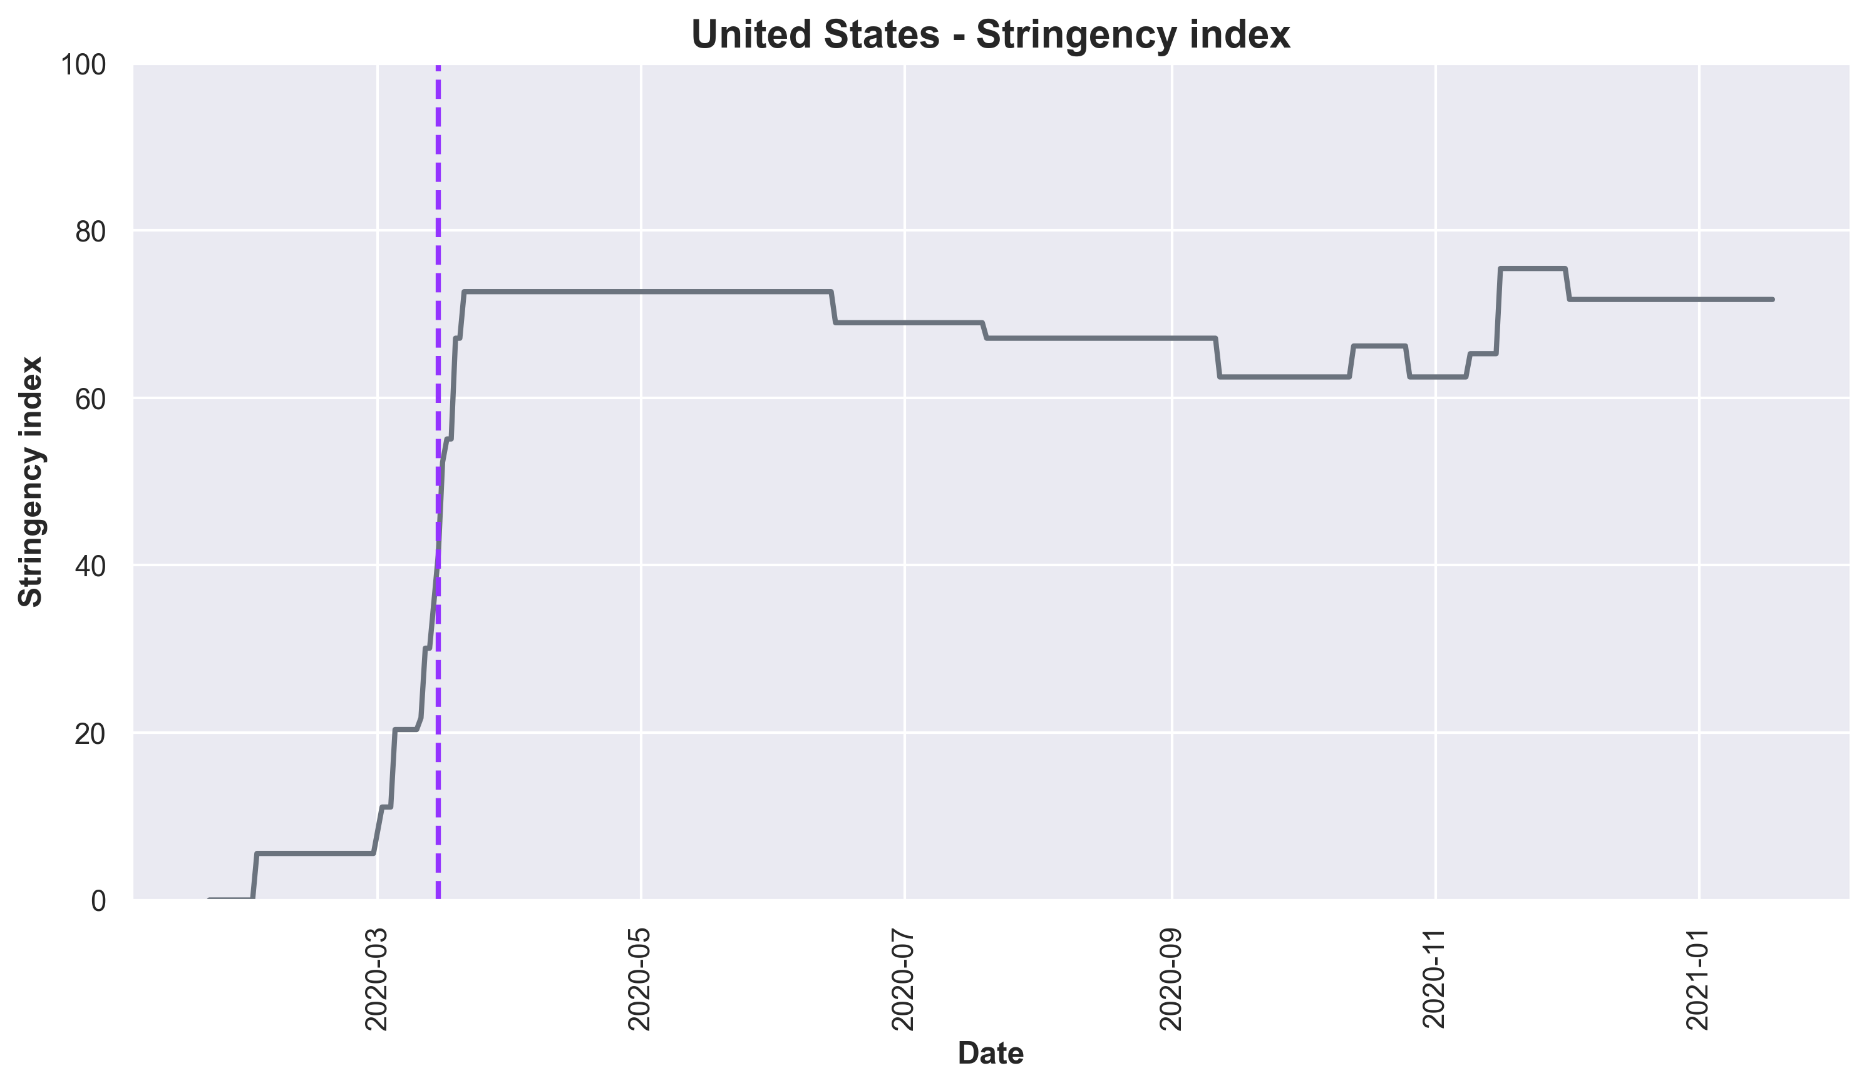
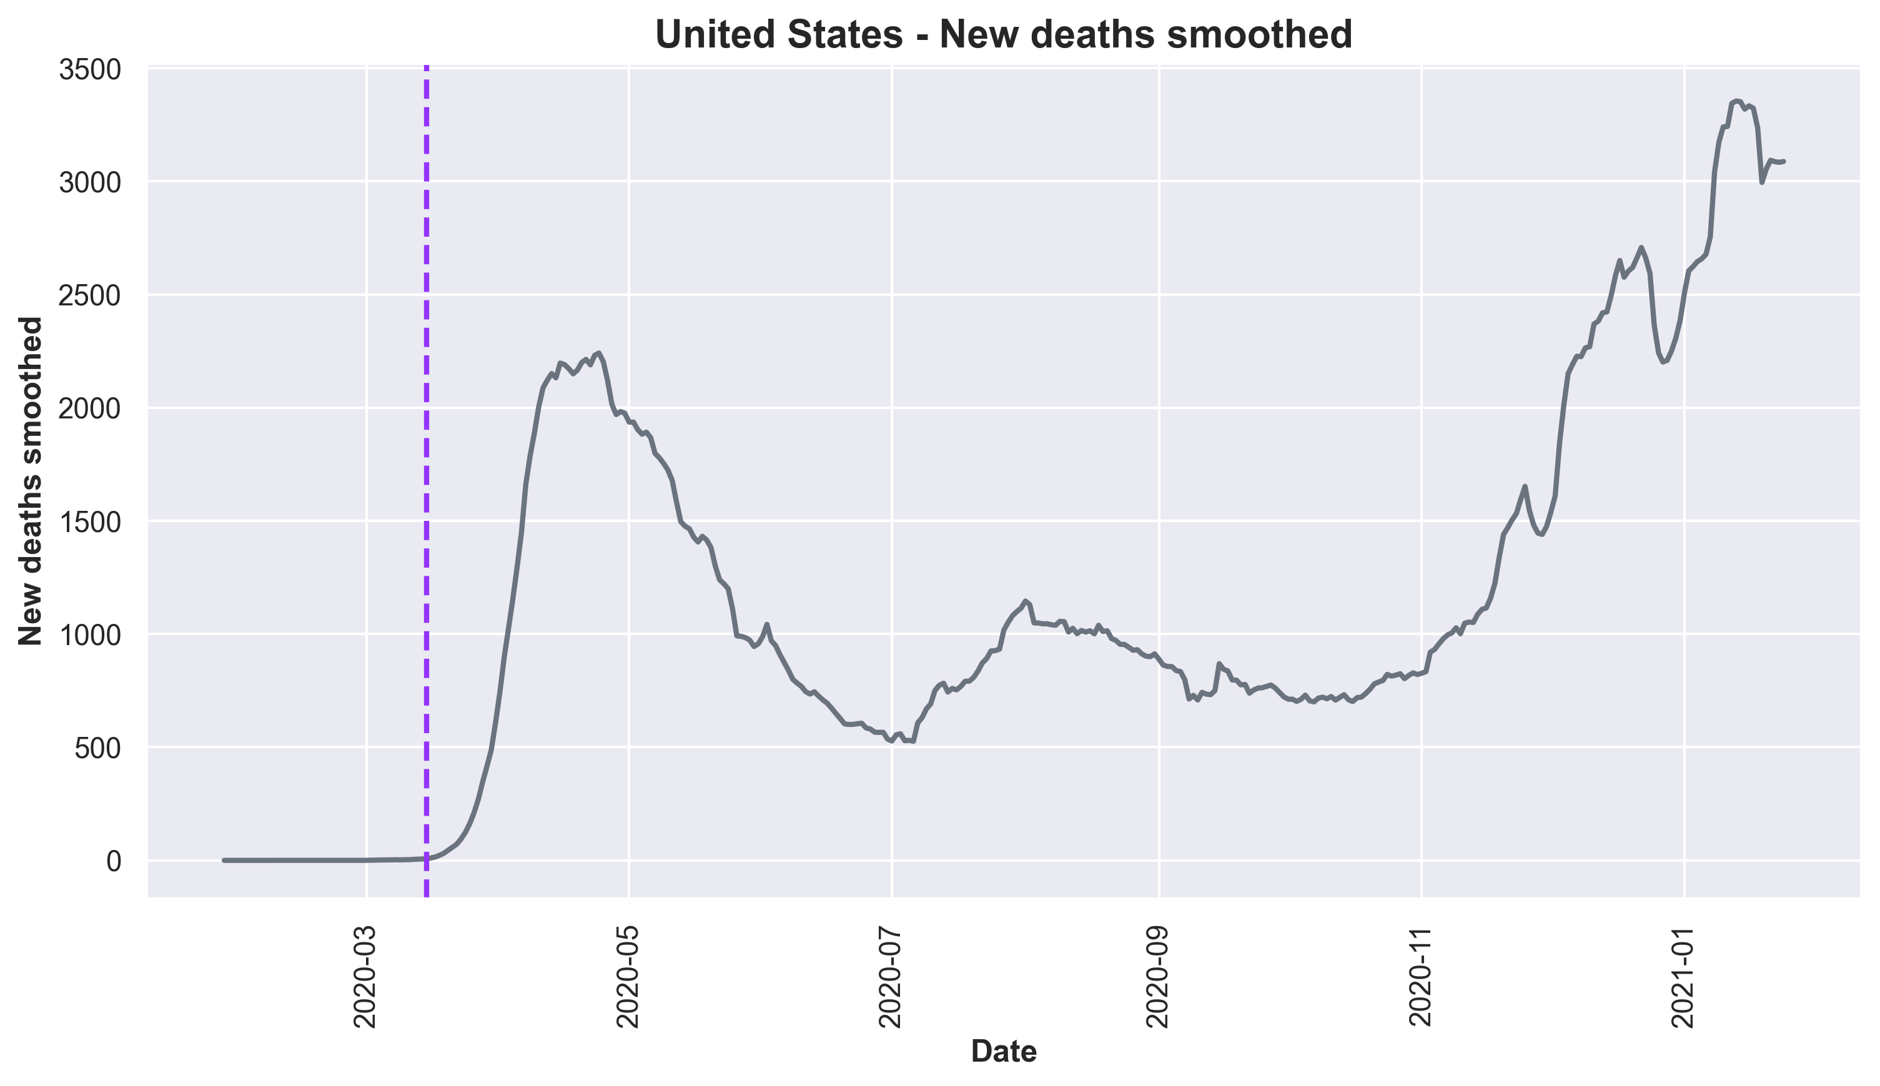
United States
COVID PROJECT | ENERO 2021

Slide 19



Conclusions
COVID PROJECT | ENERO 2021

Slide 20
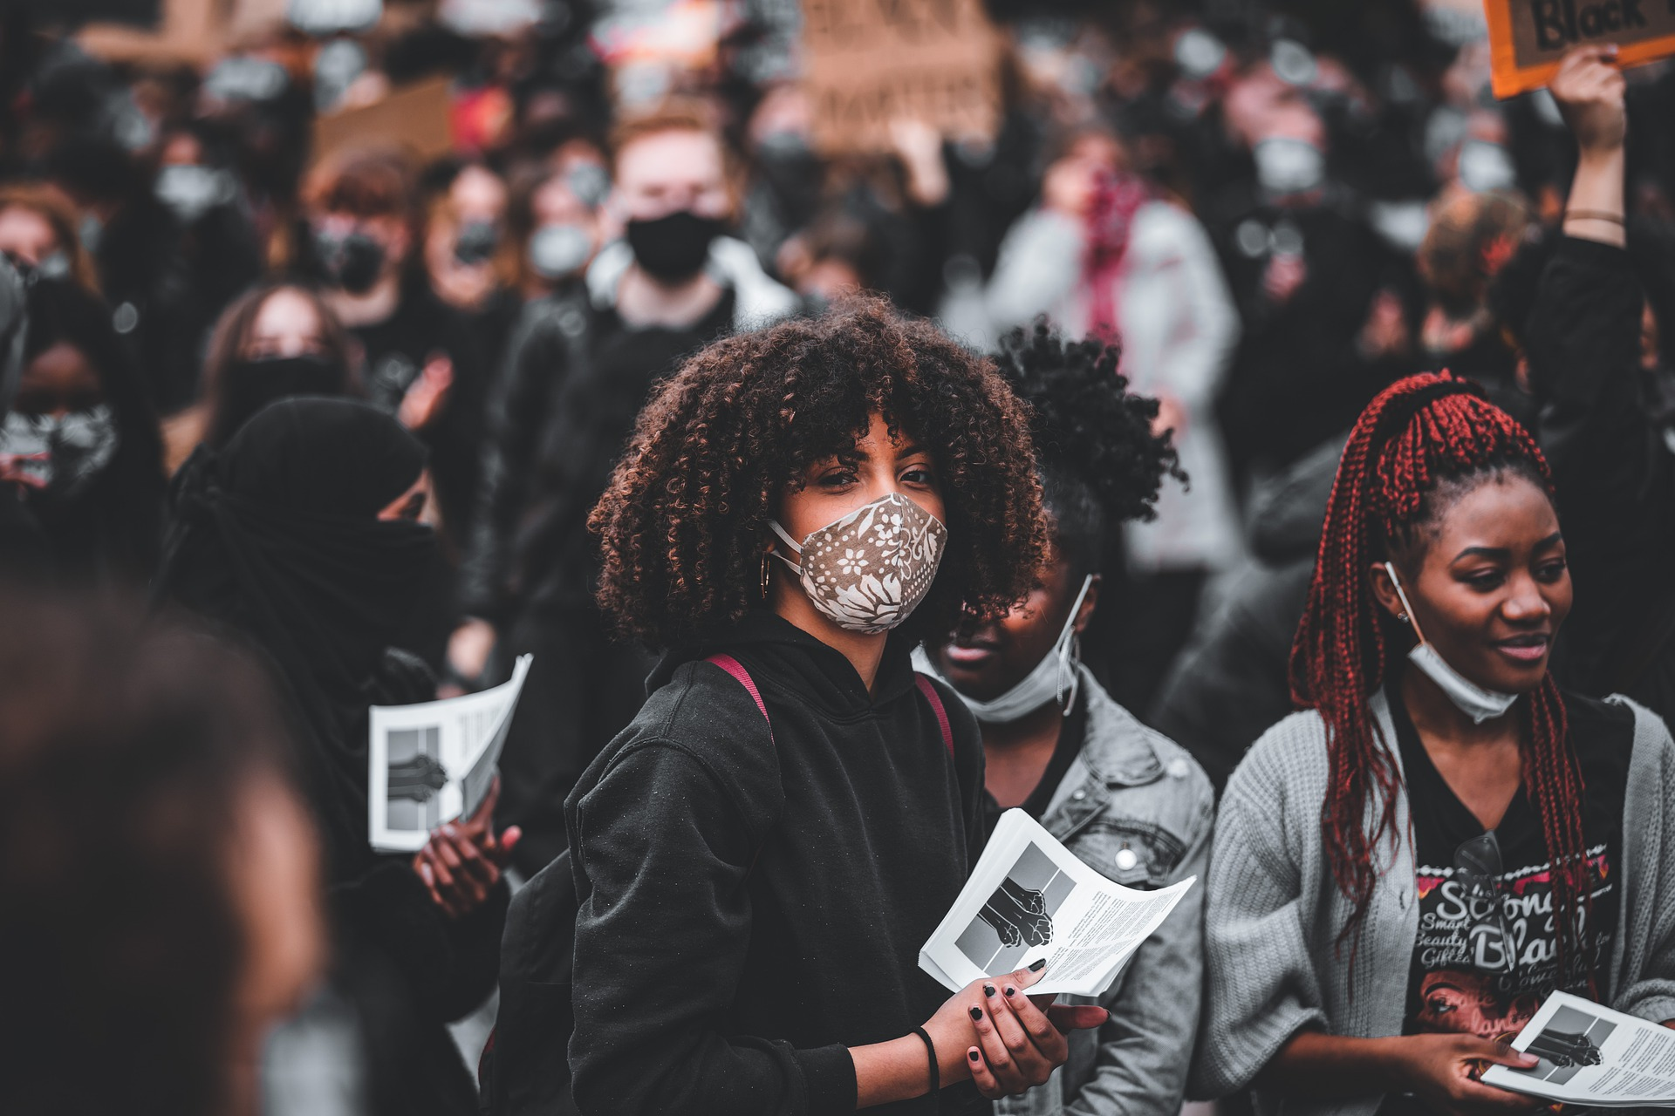
Strong restrictions (stringency index) had a positive impact in France and Spain since there were fewer infections and deaths.
Restrictions in Peru, India and United States had no impact in decreasing infections and deaths.
The death ratio (new cases vs deaths) was higher in the first wave.
COVID PROJECT | ENERO 2021

Slide 21






Thank you!
Kapil
Dadlani
kdadlani85@gmail.com
/kapil-dadlani-mirpuri
@KapilDM
Juan
Guerrero
juanige94@gmail.com
/juan-ignacio-guerrero
@JaunIgciona
María
Cagigas
Mariacagigas.s@gmail.com
/mariacagigas
@Mariacagi
COVID PROJECT | ENERO 2021

